Slide 1
DSI Capstone IDEAS Wouldn’t it be great if…….
By Alex Yi Zhou

Slide 2
Archery Posture Detector
Wouldn’t it be great if just taking a picture of yourself and the computer will be able to let you know where you are doing wrong
Potential Audience: Beginner archers
Data Source(s): taking photos of club’s best archers

Slide 3
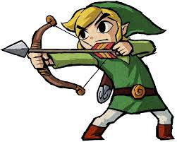
Grip too tight on bow
Head slanted
String too far from jaw
Legs too far apart
Lower body not straight
Upper body not straight

Slide 4

Research Article translator
Wouldn’t it be great if all researchers can write their papers in their own native language and other people will still read it
Potential Audience: Researcher
Data Source(s): ArXiv
Goals: to be able to translate 1 article from a particular field, into english
Success Metrics: if the article is readable, without loss or misinterpretation of content

Slide 5
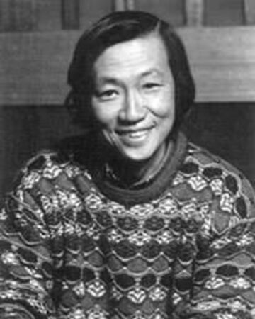
Revive the voice of the deceased
Wouldn’t it be great if I can hear Shiosawa Kaneto’s voice acting again
Potential Audience: Fujoshi around the world
Data Source(s): My collection of CD drama
Goals: reproduce dialogue using Shiosawa’s voice
Success Metrics: the voice needs to be immediately recognizable

Slide 6
Thank you for listening

